Slide 1




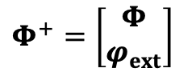




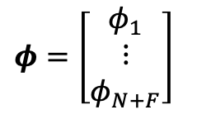

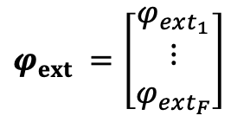

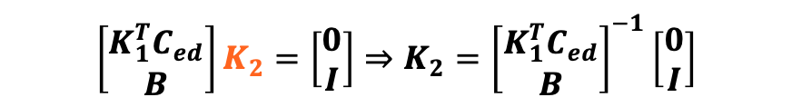
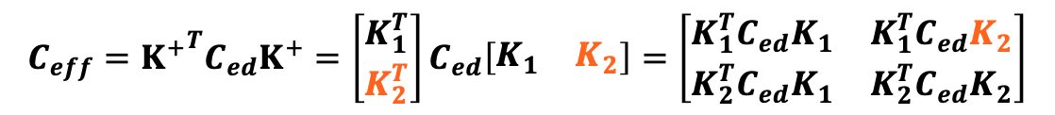

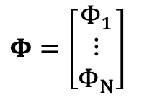
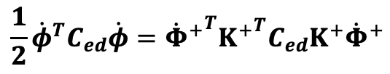


$$Φ=\left[\begin{matrix}Φ_{1} \\ ⋮ \\ Φ_{N}\end{matrix}\right]$$
$$φ=\left[\begin{matrix}φ_{1} \\ ⋮ \\ φ_{N+F}\end{matrix}\right]$$
$$φ_{ext} =\left[\begin{matrix}φ_{ext_{1}} \\ ⋮ \\ φ_{ext_{F}}\end{matrix}\right]$$
$$Φ^{+}=\left[\begin{matrix}Φ \\ φ_{ext}\end{matrix}\right]$$
$$φ=K^{+}Φ^{+}$$
$$K^{+}=\left[\begin{matrix}K_{1} & K_{2}\end{matrix}\right]$$
$$K^{+}:(N+F, N+F)$$
$$K_{1}:(N+F, N)$$
$$K_{2}:(N+F, F)$$
$$\left(N+F\right)F$$
$$\frac{1}{2}{\dot{φ}}^{T}C_{ed}\dot{φ}={{\dot{Φ}}^{+}}^{T}{K^{+}}^{T}C_{ed}K^{+}{\dot{Φ}}^{+}$$
$$C_{ed}:(N+F, N+F)$$
$${C_{eff}=K^{+}}^{T}C_{ed}K^{+}=\left[\begin{matrix}K_{1}^{T} \\ K_{2}^{T}\end{matrix}\right]C_{ed}\left[\begin{matrix}K_{1} & K_{2}\end{matrix}\right]=\left[\begin{matrix}K_{1}^{T}C_{ed}K_{1} & K_{1}^{T}C_{ed}K_{2} \\ K_{2}^{T}C_{ed}K_{1} & K_{2}^{T}C_{ed}K_{2}\end{matrix}\right]$$
$$K_{1}^{T}C_{ed}K_{2}=0$$
$$\left(N+F\right)F−NF=F^{2}$$
$$Bφ=φ_{ext}$$
$$B:(F, N+F)$$
$$BK^{+}Φ^{+}=B\left[\begin{matrix}K_{1} & K_{2}\end{matrix}\right]\left[\begin{matrix}Φ \\ φ_{ext}\end{matrix}\right]=BK_{1}Φ+BK_{2}φ_{ext}=BK_{2}φ_{ext}$$
$$BK_{2}φ_{ext}=φ_{ext}⇒BK_{2}=I$$
$$F^{2}$$
$${\left[\begin{matrix}K_{1}^{T}C_{ed} \\ B\end{matrix}\right]K}_{2}=\left[\begin{matrix}0 \\ I\end{matrix}\right]⇒K_{2}={\left[\begin{matrix}K_{1}^{T}C_{ed} \\ B\end{matrix}\right]}^{−1}\left[\begin{matrix}0 \\ I\end{matrix}\right]$$

Slide 2


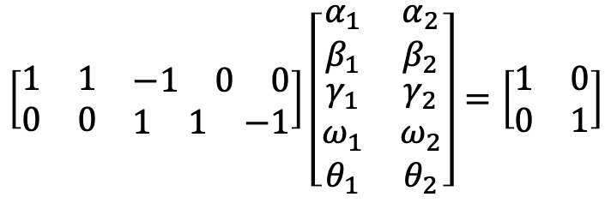
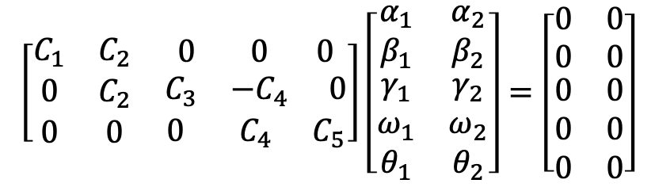
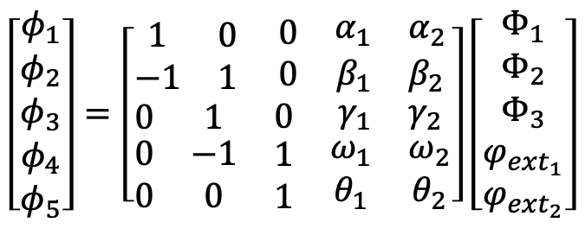
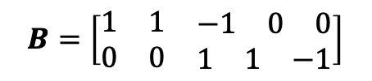
$$\left[\begin{matrix}C_{1} & C_{2} & \begin{matrix}0 & 0 & 0\end{matrix} \\ 0 & C_{2} & \begin{matrix}C_{3} & −C_{4} & 0\end{matrix} \\ 0 & 0 & \begin{matrix}0 & C_{4} & C_{5}\end{matrix}\end{matrix}\right]\left[\begin{matrix}α_{1} & α_{2} \\ β_{1} & β_{2} \\ \begin{matrix}γ_{1} \\ ω_{1} \\ θ_{1}\end{matrix} & \begin{matrix}γ_{2} \\ ω_{2} \\ θ_{2}\end{matrix}\end{matrix}\right]=\left[\begin{matrix}0 & 0 \\ 0 & 0 \\ \begin{matrix}0 \\ 0 \\ 0\end{matrix} & \begin{matrix}0 \\ 0 \\ 0\end{matrix}\end{matrix}\right]$$
$$\left[\begin{matrix}φ_{1} \\ φ_{2} \\ \begin{matrix}φ_{3} \\ φ_{4} \\ φ_{5}\end{matrix}\end{matrix}\right]=\left[\begin{matrix}\begin{matrix}1 & 0 \\ −1 & 1\end{matrix} & \begin{matrix}0 & \begin{matrix}α_{1} & α_{2}\end{matrix} \\ 0 & \begin{matrix}β_{1} & β_{2}\end{matrix}\end{matrix} \\ \begin{matrix}0 & 1 \\ \begin{matrix}0 \\ 0\end{matrix} & \begin{matrix}−1 \\ 0\end{matrix}\end{matrix} & \begin{matrix}0 & \begin{matrix}γ_{1} & γ_{2}\end{matrix} \\ \begin{matrix}1 \\ 1\end{matrix} & \begin{matrix}\begin{matrix}ω_{1} \\ θ_{1}\end{matrix} & \begin{matrix}ω_{2} \\ θ_{2}\end{matrix}\end{matrix}\end{matrix}\end{matrix}\right]\left[\begin{matrix}Φ_{1} \\ Φ_{2} \\ \begin{matrix}Φ_{3} \\ φ_{ext_{1}} \\ φ_{ext_{2}}\end{matrix}\end{matrix}\right]$$
$$B=\left[\begin{matrix}1 & 1 & \begin{matrix}−1 & 0 & 0\end{matrix} \\ 0 & 0 & \begin{matrix}1 & 1 & −1\end{matrix}\end{matrix}\right]$$
$$\left[\begin{matrix}1 & 1 & \begin{matrix}−1 & 0 & 0\end{matrix} \\ 0 & 0 & \begin{matrix}1 & 1 & −1\end{matrix}\end{matrix}\right]\left[\begin{matrix}α_{1} & α_{2} \\ β_{1} & β_{2} \\ \begin{matrix}γ_{1} \\ ω_{1} \\ θ_{1}\end{matrix} & \begin{matrix}γ_{2} \\ ω_{2} \\ θ_{2}\end{matrix}\end{matrix}\right]=\left[\begin{matrix}1 & 0 \\ 0 & 1\end{matrix}\right]$$
$$K_{1}$$
$$K_{2}$$

Slide 3

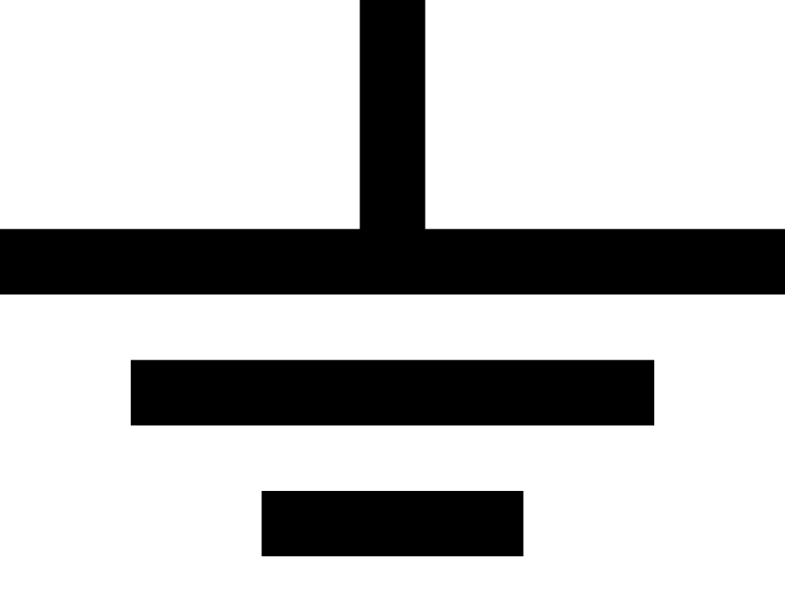








$$2$$
$$1$$
$$φ_{ext_{1}}$$
$$φ_{ext_{2}}$$
$$3$$
$$L$$
$$E_{J}$$
$$C$$

Slide 5
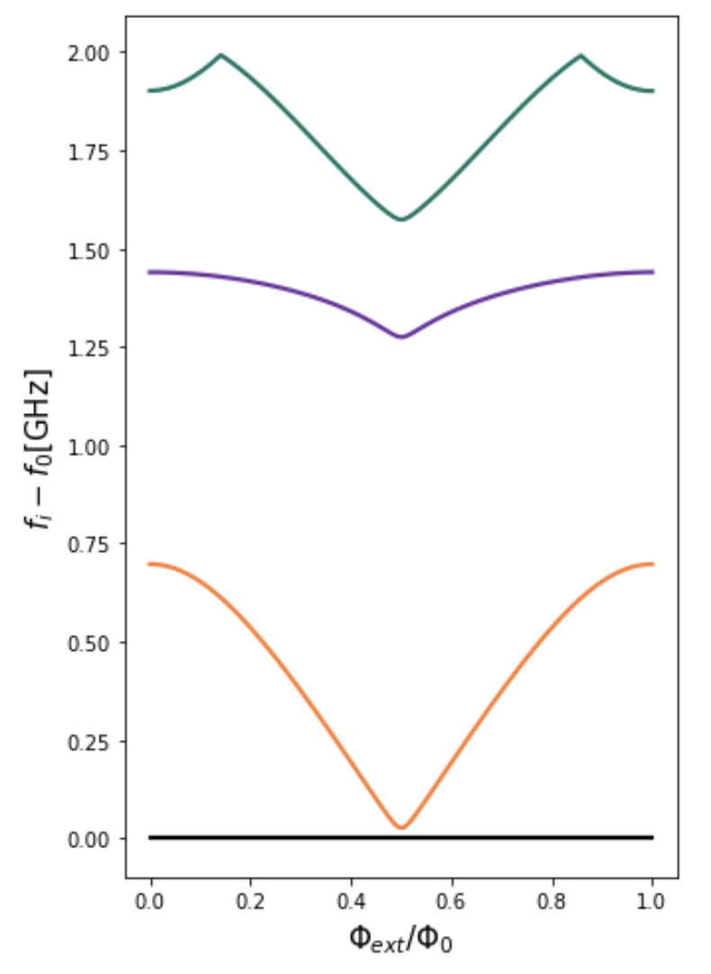


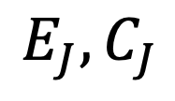
$$C$$
`\’[‘
$$L$$
$$E_{J},C_{J}$$

Slide 6
`\’[‘

Slide 7













$$2$$
$$4$$
$$Φ_{1}$$
$$Φ_{2}$$
$$Φ_{3}$$
$$1$$
$$φ_{ext_{1}}$$
$$3$$
$$φ_{ext_{2}}$$
$$5$$
$$L$$
$$E_{J}$$
$$C$$

